Slide 1




Slide 2
Aims and Objectives
In this session, you will:
Develop an understanding of Lad Culture
Learn about Student Staff Misconduct and its relationship with Lad Culture
Understand the work that undertaken so far to tackle Lad Culture
Consider strategies for tackling Lad Culture within unions and institution
Be confident to take action and tackle lad culture on their campus

Slide 3
Agenda
Introductions
What is Lad Culture?
That’s What She Said report
Student Staff Misconduct
Timeline of Lad Culture Work
How can we tackle Lad Culture?
Take action
Wrap up & Question

Slide 4

What is Lad Culture?

Slide 5
What is Lad Culture?
“A group or pack mentality residing in activities such as sport and heavy alcohol consumption, and ‘banter’ which was often sexist, misogynist and homophobic. It was also thought to be a sexualized culture which involves the objectification of women and rape-supportive attitudes, and occasionally spilled over into sexual harassment and violence.”
This description has since had racism added to it.
Notes:
This definition was defined by participants in the research we commission “That’s what she said” a study into women students’ experiences of ‘lad culture’ in higher education – with race being added to the description, as passed by NUS Women’s conference this year.

Slide 6
What is lad culture?
This is about ‘lad culture’ is not about ‘lads’.
Fundamentally about (toxic or hyper) masculinities and gender but has broader implications.
It’s not about being anti-men. We are all affected by it – and so we all need to be part of finding solutions.
Lad Culture will only be overcome by a cultural shift in higher education, not by demonising certain groups of students.

Slide 7
What is Lad Culture?
What does ‘lad culture’ look like at your institution?
What impact does it have on your students’ welfare?

Slide 8
That’s What She Said Report

Slide 9
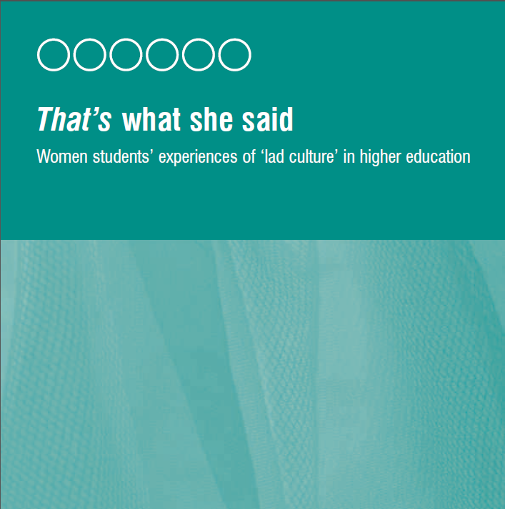
But it’s also about
Organisational culture
Notes:
9

Slide 10
That’s What She Said: key findings
Campus culture, social aspects and university ‘Nightlife’ seems to be lead by undergraduates and shaped by alcohol consumption
Campus culture and university education are gendered – with sexism and negative attitudes towards feminism throughout
Lad Culture is particularly present in extra-curricular and sport activities. Sexism from these environments spill into sexual harassment and humiliation, especially with initiations
Lad culture was reported to have been significant in personal life, experiences
in friendship groups and very difficult
to challenge

Slide 11
Impacts of ‘lad culture’
Social life
Nights out
Friendships
Personal life
Relationships
Sexual assault
Extra-curriculars
Non-participation
Victimisation
Academics
Feeling silenced
Women’s issues devalued

Slide 12
Student Staff Misconduct /
Lad Culture in Academia

Slide 13
Student Staff Misconduct
Our That’s What She Said report in 2014 on lad culture found that 37% of women and 12% of men surveyed had faced unwanted sexual advances at university.
In 2018 NUS Women’s Campaign launched its Power in the Academy: staff sexual misconduct in UK higher education report, from research into students who experience sexual misconduct from staff members at their institution.
We will discuss what misconduct is and how it interacts with lad culture.

Slide 14
Student Staff Misconduct
Why do we use the term misconduct?

Slide 15
Student Staff Misconduct
A continuum of sexualised, predatory behaviours from staff to students, behaviours that are broader than harassment
Power imbalance between staff and student, which complicates notions of consent
Ranging from everyday forms of sexual misconduct to sexual assault and rape.
These behaviours should not be seen in isolation, but play into wider rape culture
Low-key or everyday forms of sexual misconduct normalise a sexualised
environment which makes more serious
abuses more likely to occur

Slide 16
Student Staff Misconduct
How does the power imbalance complicate the notion of consent?
Why do you think this issue is perhaps less visible than student-student sexual harassment?
How do you think this links with Lad Culture?

Slide 17
Results: experiences of misconduct
We surveyed 1839 respondents and held focus groups with 15 students
41% of all respondents had experienced some form of sexualised behaviour from staff
1 in 8 of current students reported being touched by a staff member in a way that made them uncomfortable
35 (2.3%) current students reported non-consensual sexual contact by a staff member (sexual assault), while 9 reported a case of sexual assault or rape.
Notes:
These are some headline numbers which show a snapshot of these experiences
The results of our research paint higher education to be an environment where sexual misconduct, sexualised behaviour and gendered experiences of these is pervasive.
The incidents of sexual assault and non-consensual sexual contact reported by respondents show the extreme end of staff-student misconduct. But this can’t be disconnected from the continuum of behaviours described above that enable these forms of sexual violence to take place.

Slide 18
Demographic Inequalities
15.6% of women reported being touched by a staff member in a way that made them uncomfortable, compared to 7% of men.
22.9% of gay, queer and bisexual women had experienced being touched in a way that made them uncomfortable.
Around 20% of postgraduate women experienced this
Almost 8% of gay, queer and bisexual women and 7% of postgrad women had a staff member ask for sex
76% of perpetrators were men

Slide 19
Lad Culture in the Classroom
“I’ve been silenced in a classroom environment by someone who is one of the lads if you like, because I didn’t agree with something he said. He essentially did a repeat of what David Cameron did, the whole ‘calm down dear’ thing. Even the teacher who was female didn’t challenge it…” - (Participant Q)

Slide 20
Student Staff Misconduct
“I don’t really welcome uninvited sexual innuendo in my Facebook messages, not from academics, let alone from academics with power over my career” – Women students’ focus group participant
“I had to change my theme of study to avoid him, fear of campus for bumping into him, unable to participate in academic or social events within the department for fear of contact with him” – survey open text box

Slide 21
Lad Culture in Academia
Perhaps not traditional lad culture or laddish behaviour, but sense of an exclusive ‘old boys club’ that is not welcome or safe for women
Misconduct is predominantly by academic staff, who are gatekeepers of knowledge, pastoral support, and academic or career progression. This creates a structural position of trust in staff, and power imbalance that can be abused.
There is an added pressure beyond academic performance, making students and women vulnerable

Slide 22
Student Staff Misconduct
The impact of staff sexual misconduct is as vast as the impact of all sexual assault and harassment, but had noted effect on academic engagement, progression and careers, affecting relationships with supervisors, choice of modules, or even leading to some participants changing their course, university and careers.
These are similar to impacts of experiencing lad culture – social, emotional, engagement with academia, feeling safe, avoidance and even leaving the education space

Slide 23
How can we tackle Lad Culture?

Slide 24

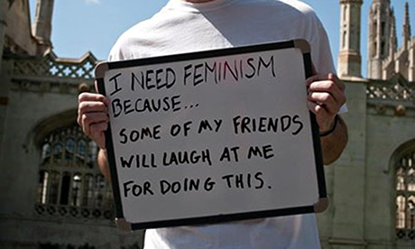
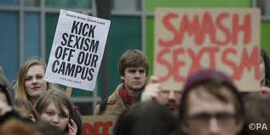


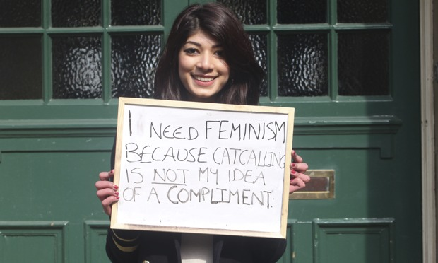

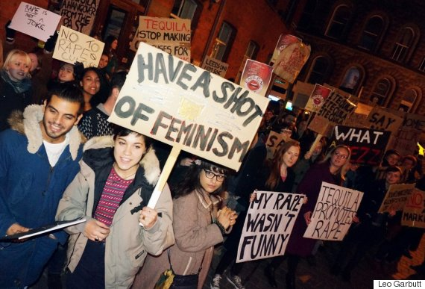


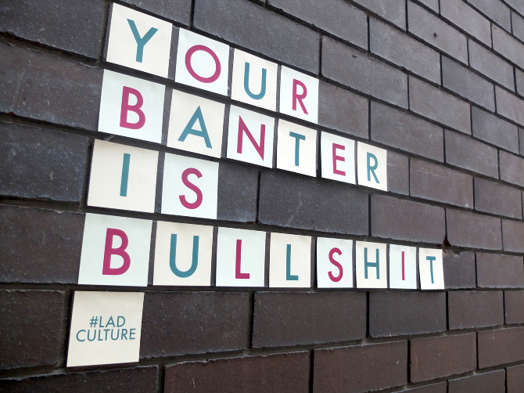
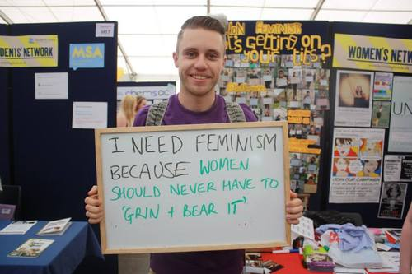
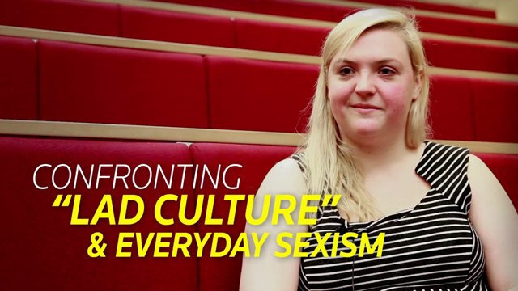
Positive actions can create change
Notes:
Campaigns from the audit
Bradford: No more page 3
UEA: Never Okay
Oxford: Sexual consent workshops
Bristol: Take Pride in UBU

Slide 25
I HEART CONSENT

Slide 26
Lad Culture Audit
As part of the campaign in 2014, NUS launched an online survey students’ unions to audit themselves and what policies, training and victim support programmes they had in place to tackle lad culture.
35 Students’ Unions replied to the survey and 20 completed the audit in full by providing supporting documents
Ranked on a scale of 1 (worst) and five (best) according to how well they met our five criteria: clarity, accessibility, attribution of responsibility, development of programme and outcome.
Survey is anonymized –SUs received the results and we created an average out of those that completed the survey
9 Students’ Unions then became part of a pilot
scheme, where we supported them in tackling lad
culture
Notes:
Clarity - on what the policy is around sexual harassment and lad culture on campus
Accessibility – making sure policy and information is accessible
Attribution of responsibility – who is responsible for dealing with these issues? Is that clear?
Development Programmes – Is there something in place that is creating and education and understanding of the issues and how they are dealt with?
Outcome – Reporting mechanisms, follow-up and services to help students deal with these incidents

Slide 27
Key findings
Policy
High proportion of SUs and institutions had E&D policy and bullying and harassment policies
Just over half of institutions (51%) had policy on sexual harassment. 65% of SUs this policy.
48% of SUs had a policy on the display of sexist/ discriminatory material. Only 1 in 10 HEIs had a policy on this.
Twice as many SUs had a zero tolerance policy than HEIs.
Less that half of SUs had a safe space policy (42%) dignity at work (39%) or alcohol abuse programme (35%)
Lack of clarity and appropriateness of complaints and disciplinary procedures
Lack of promotion of policy
Notes:
Institutions: 6.1% visibly exposed
Sus: 33.3%

Slide 28
Key findings
Training and education
1 in 10 SUs provide training on lad culture (11%) and only a third run (sexual) consent workshops (32%).
Only 6% of institutions have included consent in curriculum.
Victim Support Programmes
100% SUs and 94% of institutions provided counselling services
11% of SUs provide support meeting groups
3% of institutions provide support meeting groups
Rankings
SUs 2.75
Institutions 2.65

Slide 29
Carrying out the audit
The audit asks you to look at:
Training
Policies
Disciplinary procedures
External providers/contractors
Education
Support services
Campaigns

Slide 30
Carrying out the audit
Check your institution website
Talk to staff
Talk to staff representatives

Slide 31
Carrying out the audit
In pairs discuss:
Who needs to be involved?
Who do you need to speak to?
What are some of the current responses to tackling lad culture in your union and institution?
What challenges do you think you might face?
What are your first steps?

Slide 32
Other ways to tackle Lad Culture
Clear policies on sexual harassment, assault, and appropriate behaviours (including staff)
Review of reporting and disciplinary procedures for sexual misconduct
Workshops on consent, gender and power.
Better support systems for students, whether in-house or third party
Consultation with groups who may be effected
Zero Tolerance campaign information available on and offline

Slide 33
Take Action

Slide 34
Activity
In groups you will be given a different form action. You have 10 minutes to plan your action and then will present to the rest of the group for a maximum of 5 minutes.
Group 1 | Group 2 | Group 3
Audit Tool | Pledge Promise / Poster | Cohesive campaigning

Slide 35
Group reflection
What task or activity did you like the most?
Which did you think is the most effective and why?

Slide 36
Thank you for coming!
Watch this space and get in touch
for more info:
w: www.nusconnect.org.uk
e: women@nus.org.uk

