Slide 1
Student Led Scrutiny of an Executive Officer Team

Slide 2
Session Plan
Overview of BCU
Overview of BCUSU
The Student Voice Team
Our journey
Byelaw changes
Scrutiny Group
Discussion

Slide 3
Disclaimer/Essential Info
I talk very fast…
Plenty of operational information
The system has only been in place for 1 year
I definitely don’t have all the answers

Slide 4
Prizes…
Guess whether the quotes are from:
The Scrutiny Group Panel
The Executive Officer Committee
BCUSU Staff

Slide 5
BCU Overview
University status in 1992 (University of Central England)
2007 Birmingham City University
24,064 students*
6 campuses
71% commuter students**
63% female students, 36% male students*
53% white students, 45% BAME*
*2015-16 University data
**2014-15 University data

Slide 6
BCUSU Overview
4,082 voters (18%)
4,102 student group members
710 Student Academic Leaders and School Reps
5 full time Executive Officers, 7 PTO’s
Around 50 full time staff and anywhere between 100 and 250 student staff
Partnership approach

Slide 7
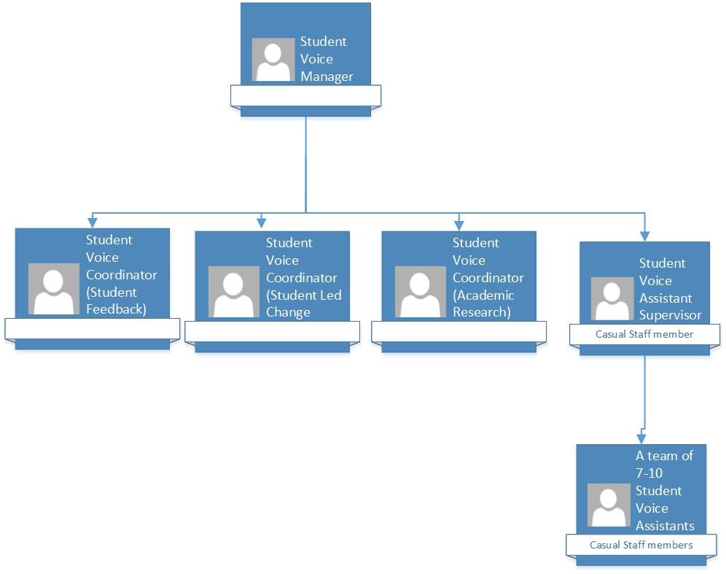
Student Voice Team

Slide 8
Student Voice Journey
BCUSU Strategic Plan 2012-2015
Theme: Voice & Representation
Goal: We will facilitate integrated, connected student representatives at all levels which influences positive change

Slide 9
Student Voice Journey
£122,000 (2012) to £280,000 (2017)

Slide 10
N/A(2012) to 614(2017)

Slide 11
N/A (2012) to 9,761(2017)

Slide 12
1,485 (2012) to 4,226 (2016)

Slide 13
Quote 1:
“Particular individuals with a passion on certain topics will dominate the floor and not let others get involved in the discussion.”
Options:
Scrutiny Group Panel Member
Executive Committee Member
BCUSU Staff

Slide 14
Quote 2:
“So much more effective than Student Council. The quality of discussion is fantastic.”
Options:
Scrutiny Group Panel Member
Executive Committee Member
BCUSU Staff

Slide 15
Out with the old…
Student Council
Struggling to hit quoracy
Officers not really held to account
Lack of engagement
AGM
“Bribes” needed to reach quoracy
Students not engaged in meeting
Formal delivery

Slide 16
In with the new…
Student Advisory Panel
16 randomly selected BCU students
Representative of the University population
Ideas submitted online
Panel makes recommendations to the Officer team
Student Members Meeting
No quoracy
More informal style
(AGM and company meeting held by trustee board)
AND…

Slide 17
Scrutiny Group
5 students employed by BCUSU to hold the Executive Officer team to account
Quoracy of 3 panel members for each meeting
Facilitated by the Student Voice Facilitator (student staff member) who must remain impartial.
4-6 meetings per academic year

Slide 18
Quote 3
“The panel don’t talk to enough students to have an objective opinion. They just use their own opinions and that could be flawed.”
Options:
Scrutiny Group Panel Member
Executive Committee Member
BCUSU Staff

Slide 19
Quote 4
“The members of Scrutiny Panel receive intensive training so they are fully aware of what the officers should be working on from their manifestos, policy and job descriptions which means they can truly hold the officers to account, which is a first at BCUSU!”
Options:
Scrutiny Group Panel Member
Executive Committee Member
BCUSU Staff

Slide 20
Scrutiny Group Agenda
Review of the minutes and decisions from the previous meeting
Receive a report from the Executive Committee on their priorities and work over the year.
The opportunity for student members to raise issues of concern
Receive actions from the Student Advisory Panel detailing recommendations on Ideas for and against with justification on Executive Officers final decisions.
Any other business

Slide 21
Scrutiny Group Power of 3
Hold the Executive Officers to account.
Have knowledge of the BCUSU Governance Structures and Bye-Laws
Work closely with the Student Advisory Panel

Slide 22
Student Voice Facilitator Power of 3
Facilitate the Student Advisory Panel
Facilitate the Scrutiny Group
Facilitate the Student Members Meeting

Slide 23
Quote 5
“Finally get to show these lot they are not perfect!”
Options:
Scrutiny Group Panel Member
Executive Committee Member
BCUSU Staff

Slide 24
Quote 6
“It’s amazing how much the Sabbs blag to get their point across”
Options:
Scrutiny Group Panel Member
Executive Committee Member
BCUSU Staff

Slide 25
Training
Led by Student Voice Coordinator
Panel provided with
BCUSU Byelaws
Power of 3 for each member of the Officer team
Election manifestos
Officer yearly campaign plan
Policies Officers are mandated to work towards

Slide 26
Scrutiny Group Power
Censure of the Executive Officer.
Request the Trustee Board approve the suspension of the Executive Officer from duty, for a period not exceeding one month.
Request the Trustee Board call a Referendum as outlined in Bye-law 9 to consider the removal of the Executive Officer.
The Scrutiny Group will then vote on which action to take with a simple majority prevailing

Slide 27
Scrutiny Group Power
Safeguards
Trustee Board must approve any suspension or call for referendum

Slide 28
Action taken 16-17
5 Officer censures
1 call for suspension (not upheld by Trustee Board)
2 PTO’s removed from post

Slide 29
Other Quotes
Group Panel Members
Negative –
“Staff are not prepared to take forward our recommendations and will look for a ‘way out’”
“The Exec don’t take this meeting seriously. One of them fell asleep in it!”
“Could have done with more of an explanation on what happens after our decisions are made.”
“Students on my course don’t know that this system exists.”

Slide 30
Other Quotes
Group Panel Members
Positive –
“Feel like I’m actually having chance to shape how my SU works and the sort of projects I want them to be working on.”
“Great work experience to supplement my course.”
“Given me a fantastic insight into how the SU and Exec work. But not sure I’m brave enough to be an officer and face this!”
“Can I do this job even when I’m not a student anymore?”
“I didn’t realise how much work the Exec actually get through. I was glad I was able to sit down and thank them in person rather than just presuming they sat on Facebook or messed around with their mates all day.”

Slide 31
Other Quotes
Executive Officers
Negatives –
“The panel don’t know what they’re talking about as they are not Sabbs. How can they judge us when they don’t get it?”
“Can we please have Student Council back?”
“The panel don’t talk to enough students to have an objective opinion. They just use their own opinions and that could be flawed.”
“If we’re democratic we should be electing in the members of the panel rather than interviewing them.”
“2 minutes isn’t long enough for me to give a fair reflection on all the work I have been doing.”
“It feels like certain members of the team get away with not doing what they are supposed to be doing.”
“It needs to be more transparent; reports online, live stream of the meeting.”

Slide 32
Other Quotes
Executive Officers
Positives -
“Glad to gain more student feedback and opinion on the work I am doing.”
“So much more effective than Student Council. The quality of discussion and the fact we actually get held to account is fantastic.”
“Can we get more students involved in the meeting so we can get more voices in the room?”

Slide 33
Other Quotes
BCUSU Staff
“The facilitator can’t help but say something at times”
“The sabbs hate this meeting, must be working”
“I don’t understand why they don’t take the comments of the group on board and just stick within their job descriptions”
“Can we come and watch with popcorn!?”
“Everyone is accountable to someone, probably one of the most important things they will learn this year.”

Slide 34
Areas for improvement
Ensure the meeting becomes more transparent:
Decisions made by the group publicised on social media and the BCUSU website.
Reports submitted 2 weeks before the meeting and publicised on social media to allow students to submit comments and feedback that could be used by the Scrutiny Group to aid the conversation.

Slide 35
Areas for improvement
Ensure the meeting becomes more transparent:
Students on the panel encouraged to talk to students about their views/thoughts on the Executive Committees performance.
Invite students to attend the meeting as observers.
Stream on Facebook the part of the meeting where the officers are giving their reports and facing questions from the group.

Slide 36
Areas for improvement
Ensure that the facilitator remains ‘neutral’ in all conversations. At times during the year accusations were made that the facilitator was influencing the flow/direction of conversation.
The Executive Committee shouldn’t be allowed anytime to give a verbal report. This would encourage them to take more care with their reports and actually produce high quality ones rather than just ‘throwing’ something together at the last moment.

Slide 37
Areas for improvement
Allow for students to submit questions to the group that they want the answer to.
Make it clearer to the group the process that is followed following a decisions that they then make.
Provide the Executive Committee with more training/preparation. This was something that was refused by the current officer team as they felt they didn’t need it.

Slide 38
Any questions?

Slide 39
Discussion
How do you hold Officers to account?
Does anyone have a similar structure?
Would anyone like to share any top tips?

