Slide 1
Using service intelligence to campaign
John Bibby, Senior Policy Officer

Slide 2
In the next 30 minutes…
Example – outlawing retaliatory evictions in England
How does Shelter use service intelligence to campaign?
What are the dependencies and impact on services?

Slide 3
1. Example – outlawing retaliatory evictions in England

Slide 4
1. Outlawing retaliatory evictions in England
Where did the campaign come from? Pre-2014
Shelter has advice services face-to-face, over the phone and online
Our services told us that clients were being evicted in retaliation for making complaints and that this was a barrier to improving housing conditions – so we decided this should be a priority area for campaigning
Notes:
Shelter services

Slide 5
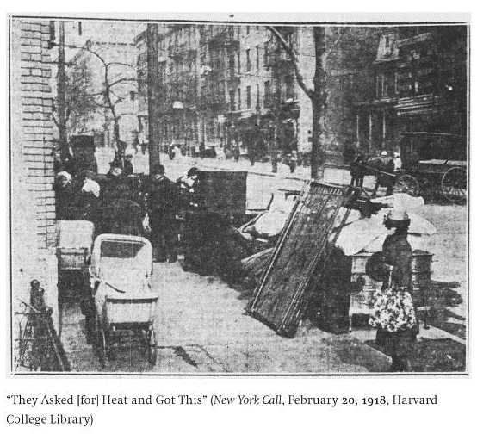
1. Outlawing retaliatory evictions in England
Time out. What is retaliatory eviction?

Slide 6
1. Outlawing retaliatory evictions in England
Time out. What is retaliatory eviction?
English law gives renters a minimum of 6 months’ protection from eviction
After that they can be evicted at any time with 2 months’ notice, unless they have agreed a fixed term contract
They can be evicted without reason (Section 21)
This makes them very vulnerable to eviction if they ask for improvements to their property

Slide 7
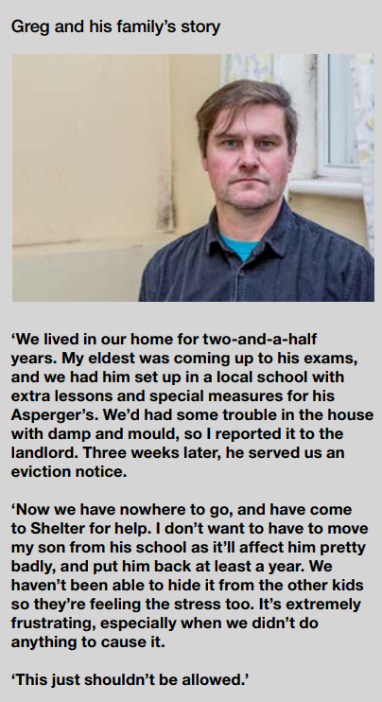
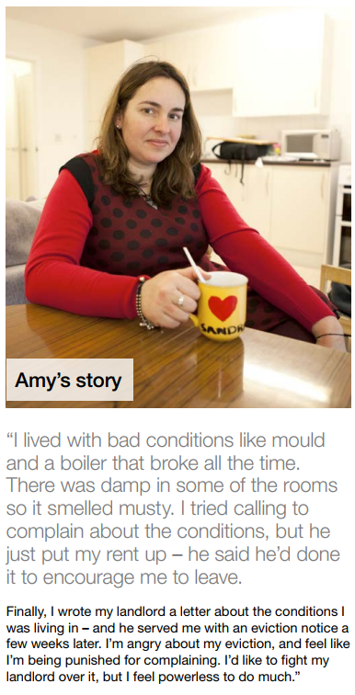
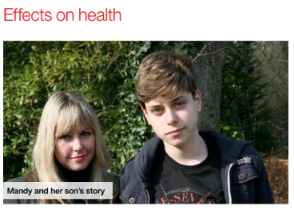
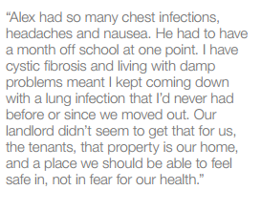
1. Outlawing retaliatory evictions in England
Understanding the nature of the problem with real stories – Spring 2014
Notes:
Two case study officers based in our media team

Slide 8
1. Outlawing retaliatory evictions in England
What did we do next? Understanding the extent of the problem – January 2014
We used our large tenants survey to establish 11% of renters had been frightened to ask for improvements and 3% had been evicted in retaliation
This is equivalent to 200,000 renters experiencing it in 5 years
We used other sources of statistics to stack up case that conditions in private renting are a problem
Notes:
Our research team

Slide 9
1. Outlawing retaliatory evictions in England
Developed a solution – March 2014
Providing international comparisons
Making a recommendation for a legal change
Legal services helping to draft suggested bill
Notes:
Policy team and legal team

Slide 10
1. Outlawing retaliatory evictions in England
Highlighting the problem – March to May 2014
Launched national campaign with petition
Supported by media (national press, local and national broadcast)
Using headline stat – 200,000 face revenge eviction
Case studies willing to appear in media
With call to action (outlaw revenge eviction)
Notes:
Policy team and legal team

Slide 11
1. Outlawing retaliatory evictions in England
Lobbying for change – Spring 2014-Spring 2015
Meeting with government officials to understand attitude to change
Using existing relationships to get an MP to take forward a private members’ bill
Supporting bill through Parliament (process of it being defeated, getting additional government support, getting an equivalent amendment introduced to the Deregulation Bill, corralling support)
Becomes law in March 2015
Outlawed for new tenants from 2015
Notes:
Public affairs

Slide 12
2. How does Shelter use service intelligence to campaign?

Slide 13
2. How does Shelter use service intelligence
Understanding
Informs what we campaign on
Credibility
Frontline experience opens doors with decision makers for lobbying
Communicating
Case studies for media
Helps us understand the qualitative nature of problems
Should help inform our solution
Helps build internal consensus as grounds us in our area of expertise
Informs how we talk about problems
Engaging with supporters and getting wider reach e.g. through social media
Notes:
Public affairs

Slide 14
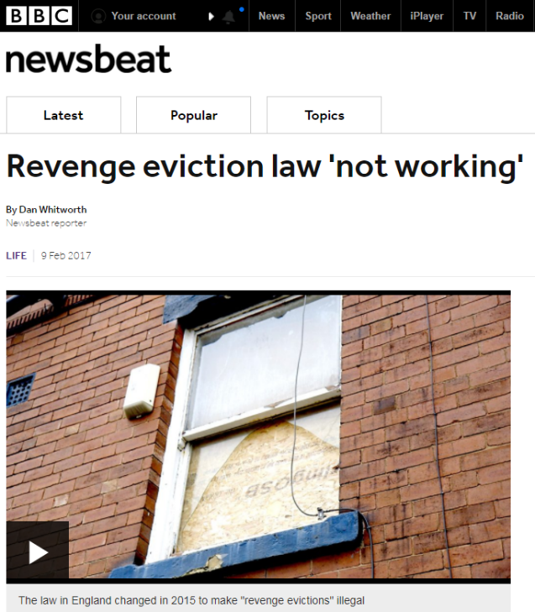
2. How does Shelter use service intelligence
Where we probably could have done more – solution design
Our services continue to report retaliatory eviction as a problem, so further change is needed
Could this have been resolved by greater service input in solution design?
Notes:
Public affairs

Slide 15
3. What are the dependencies and impact on services?

Slide 16
3. What are the dependencies and impacts?
Recap – How do we use service intelligence?
Understanding
Informs what we campaign on
Credibility
Frontline experience opens doors with decision makers for lobbying
Communicating
Case studies for media
Helps us understand the qualitative nature of problems
Should help inform our solution
Helps build internal consensus as grounds us in our area of expertise
Informs how we talk about problems
Engaging with supporters and getting wider reach e.g. through social media
Notes:
Public affairs

Slide 17
3. What are the dependencies and impacts?
Dependencies – Shelter is a big team…
Informs what we campaign on
Public affairs team
Frontline experience opens doors with decision makers for lobbying
Media and case study team
Case studies for media
Helps us understand the qualitative nature of problems
Should help inform our solution
Helps build internal consensus as grounds us in our area of expertise
Informs how we talk about problems
Engaging with supporters and getting wider reach e.g. through social media
Policy team
Research team
Programme management
Capacity to engage services
Social media team
Campaigns and supporter team
Notes:
Public affairs

Slide 18
3. What are the dependencies and impacts?
Impact – what are the costs for services?
Logging client data (impact on time – helped if you have dedicated case study team)
Flagging relevant cases (impact on considerations while giving advice)
Strategic feedback and joint work (impact on leadership teams with strategic overview)
Slow pace of change (impact on faith in continued involvement)
Notes:
Public affairs

Slide 19
3. What are the dependencies and impacts?
Thoughts on downscaling and implementing in small teams
Cutting your coat… - what are achievable campaign objectives for small services or individual advisers?
Bigger than the sum… - How can small teams or individual advisers work jointly to benefit from economies of scale?
Beg, steal or borrow… - Can small teams harness other external campaign resources?
Notes:
Public affairs

Slide 20
Questions and discussion

