Slide 1
One Million Voices (filling an embarrassing silence)

Slide 2
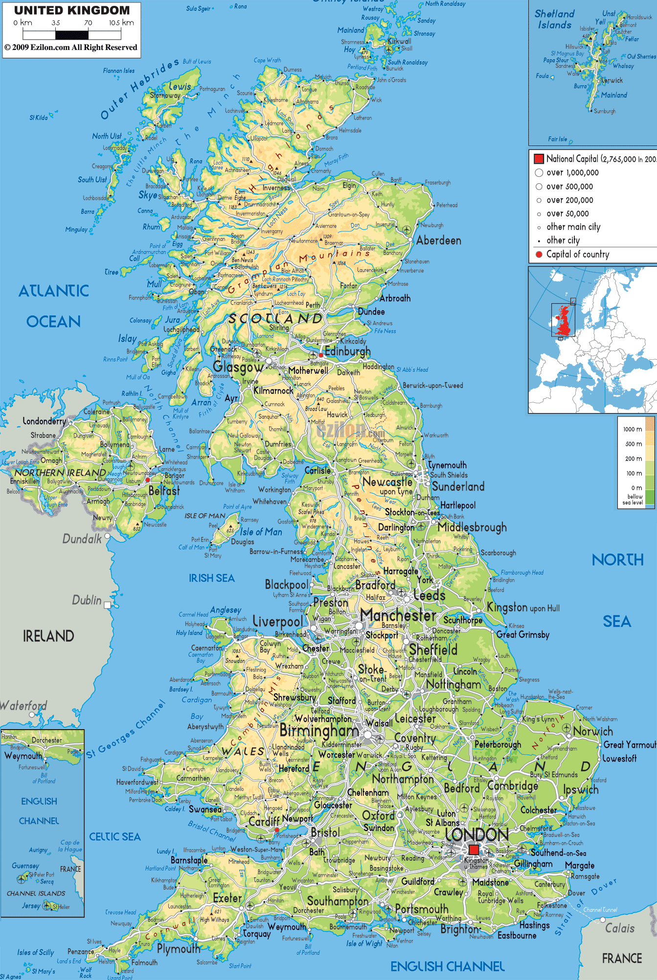
The story so far
600 apprentices across 40 colleges, workplaces and training providers have identified set of priorities.

Slide 3
Priorities
Pay
Careers Advice
Working Conditions
Learning on the job
Learning off the job
Access to Apprenticeships
Respect as an apprentice
Involvement in decision making
Making sure apprentices get a job when they finish

Slide 4
What can we do in my college?
Here are 6 activities other colleges have used:
Data Data Data
Do it again but different
All about the Money
Drop in, don’t drop out
Meet the decision maker
Telling Stories

Slide 5
Data data data!
In exactly the same way as engaging full time learners, knowing who and where your apprentices are is definitely step 1
How many
Gender/Age/Disability
Day/Block/Workplace
Frameworks
Attendance Days

Slide 6
Do it again, but different
Pick the area of work that you feel is absolutely bombproof.
Course Reps
Exec roles
Sports and Activities
Events

Slide 7
Its all about the money…
Apprentices have consistently, across the UK, identified pay and employment as being key priorities.
Careers and progression events
Working with TU’s – follow the money
One off apprentice voice activities

Slide 8
Drop in, don’t drop out
Both colleges and training providers have begun to use surgeries/drop in sessions to facilitate learner voice.
Regular, timetabled online chat
Structured surgeries
Flow chart – who deals with what
Assessors online
Roving reporter

Slide 9
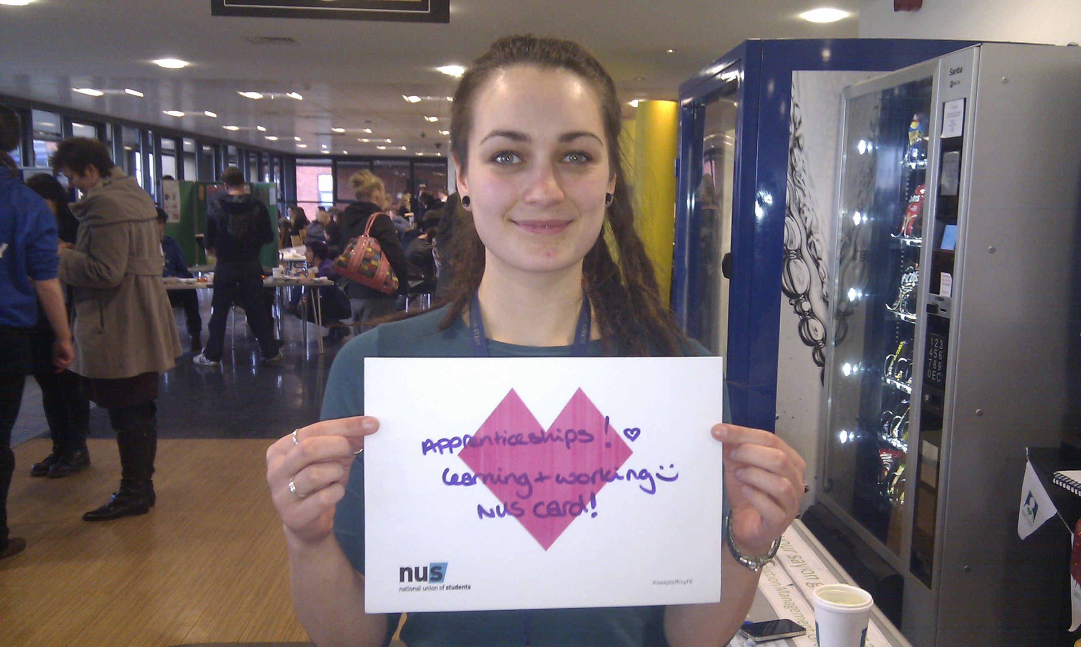
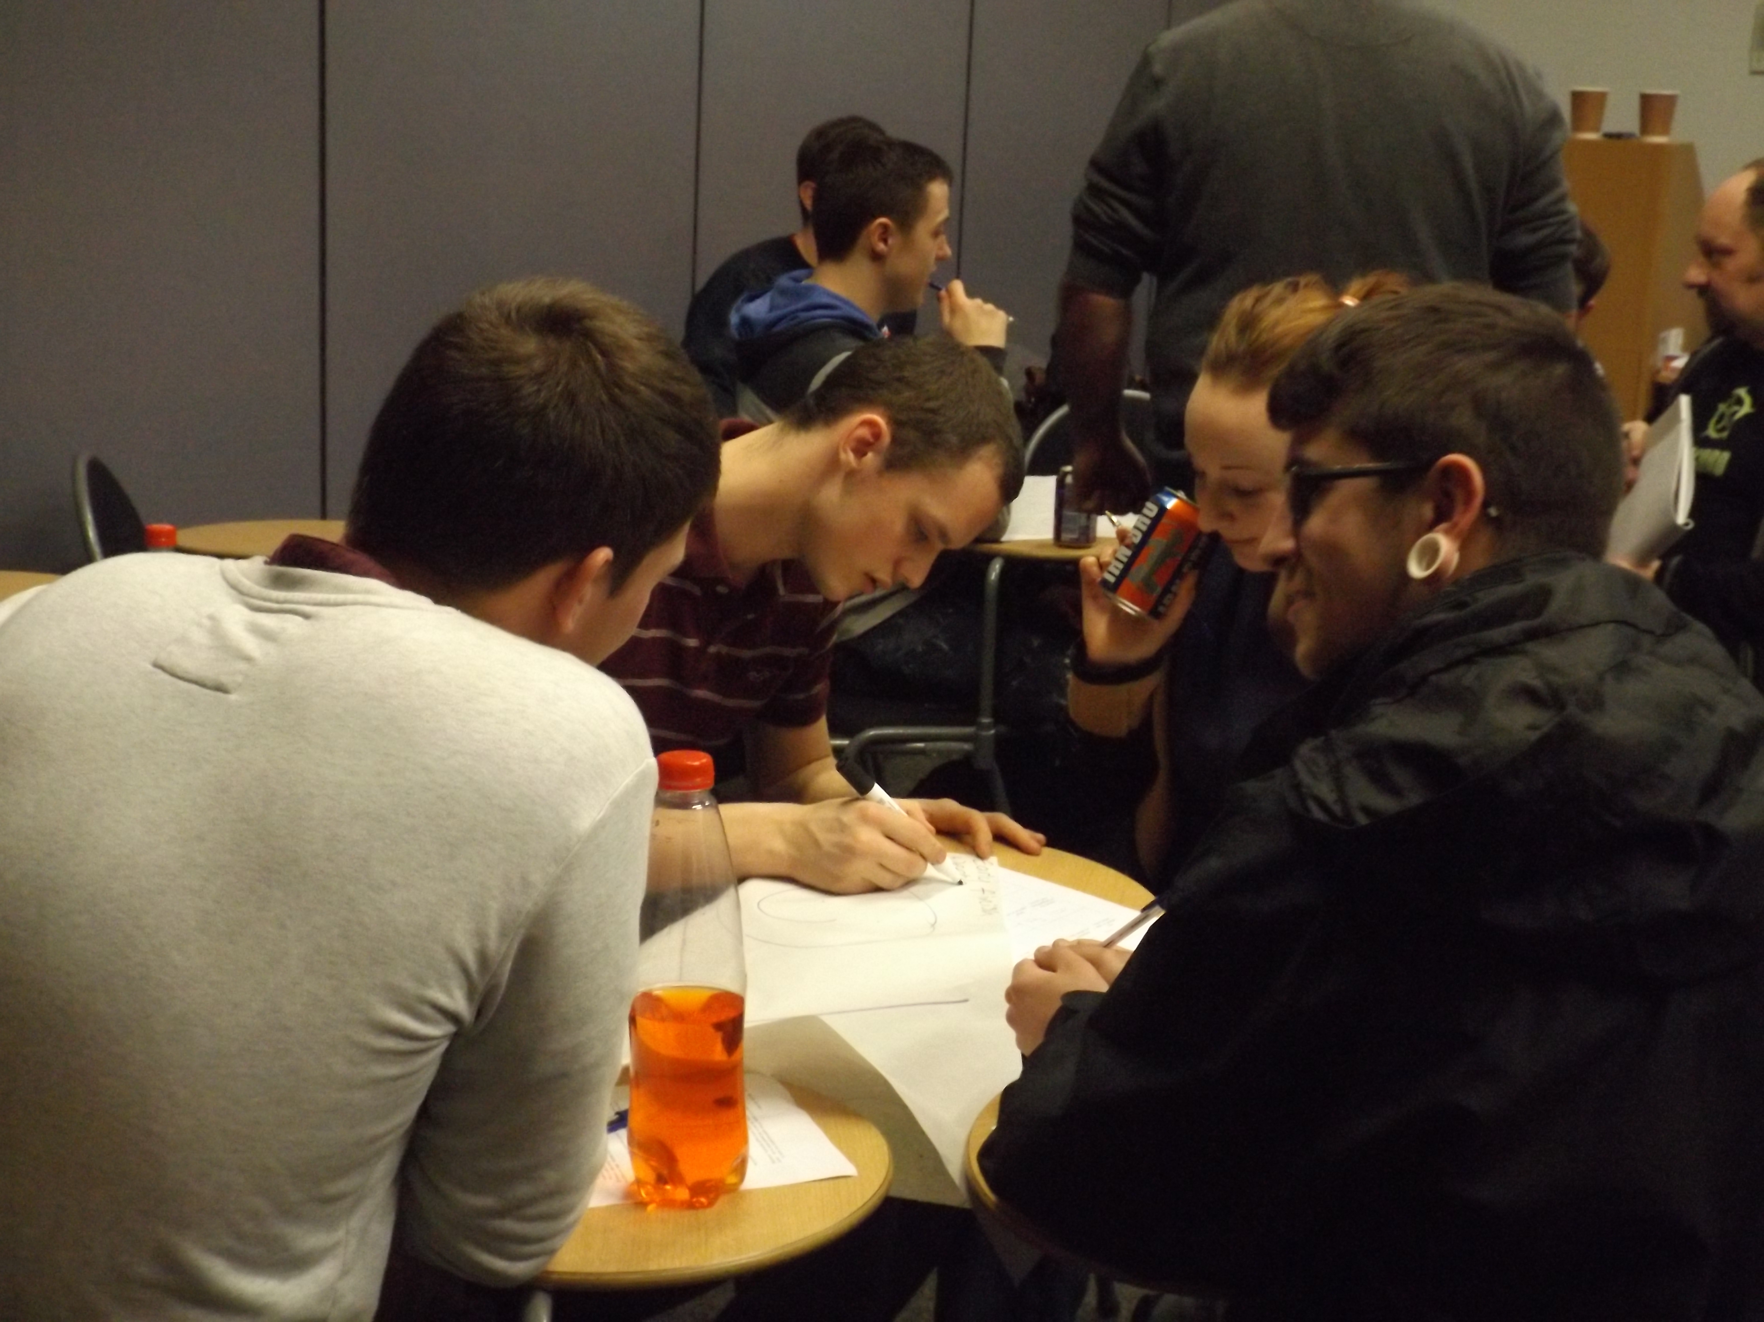
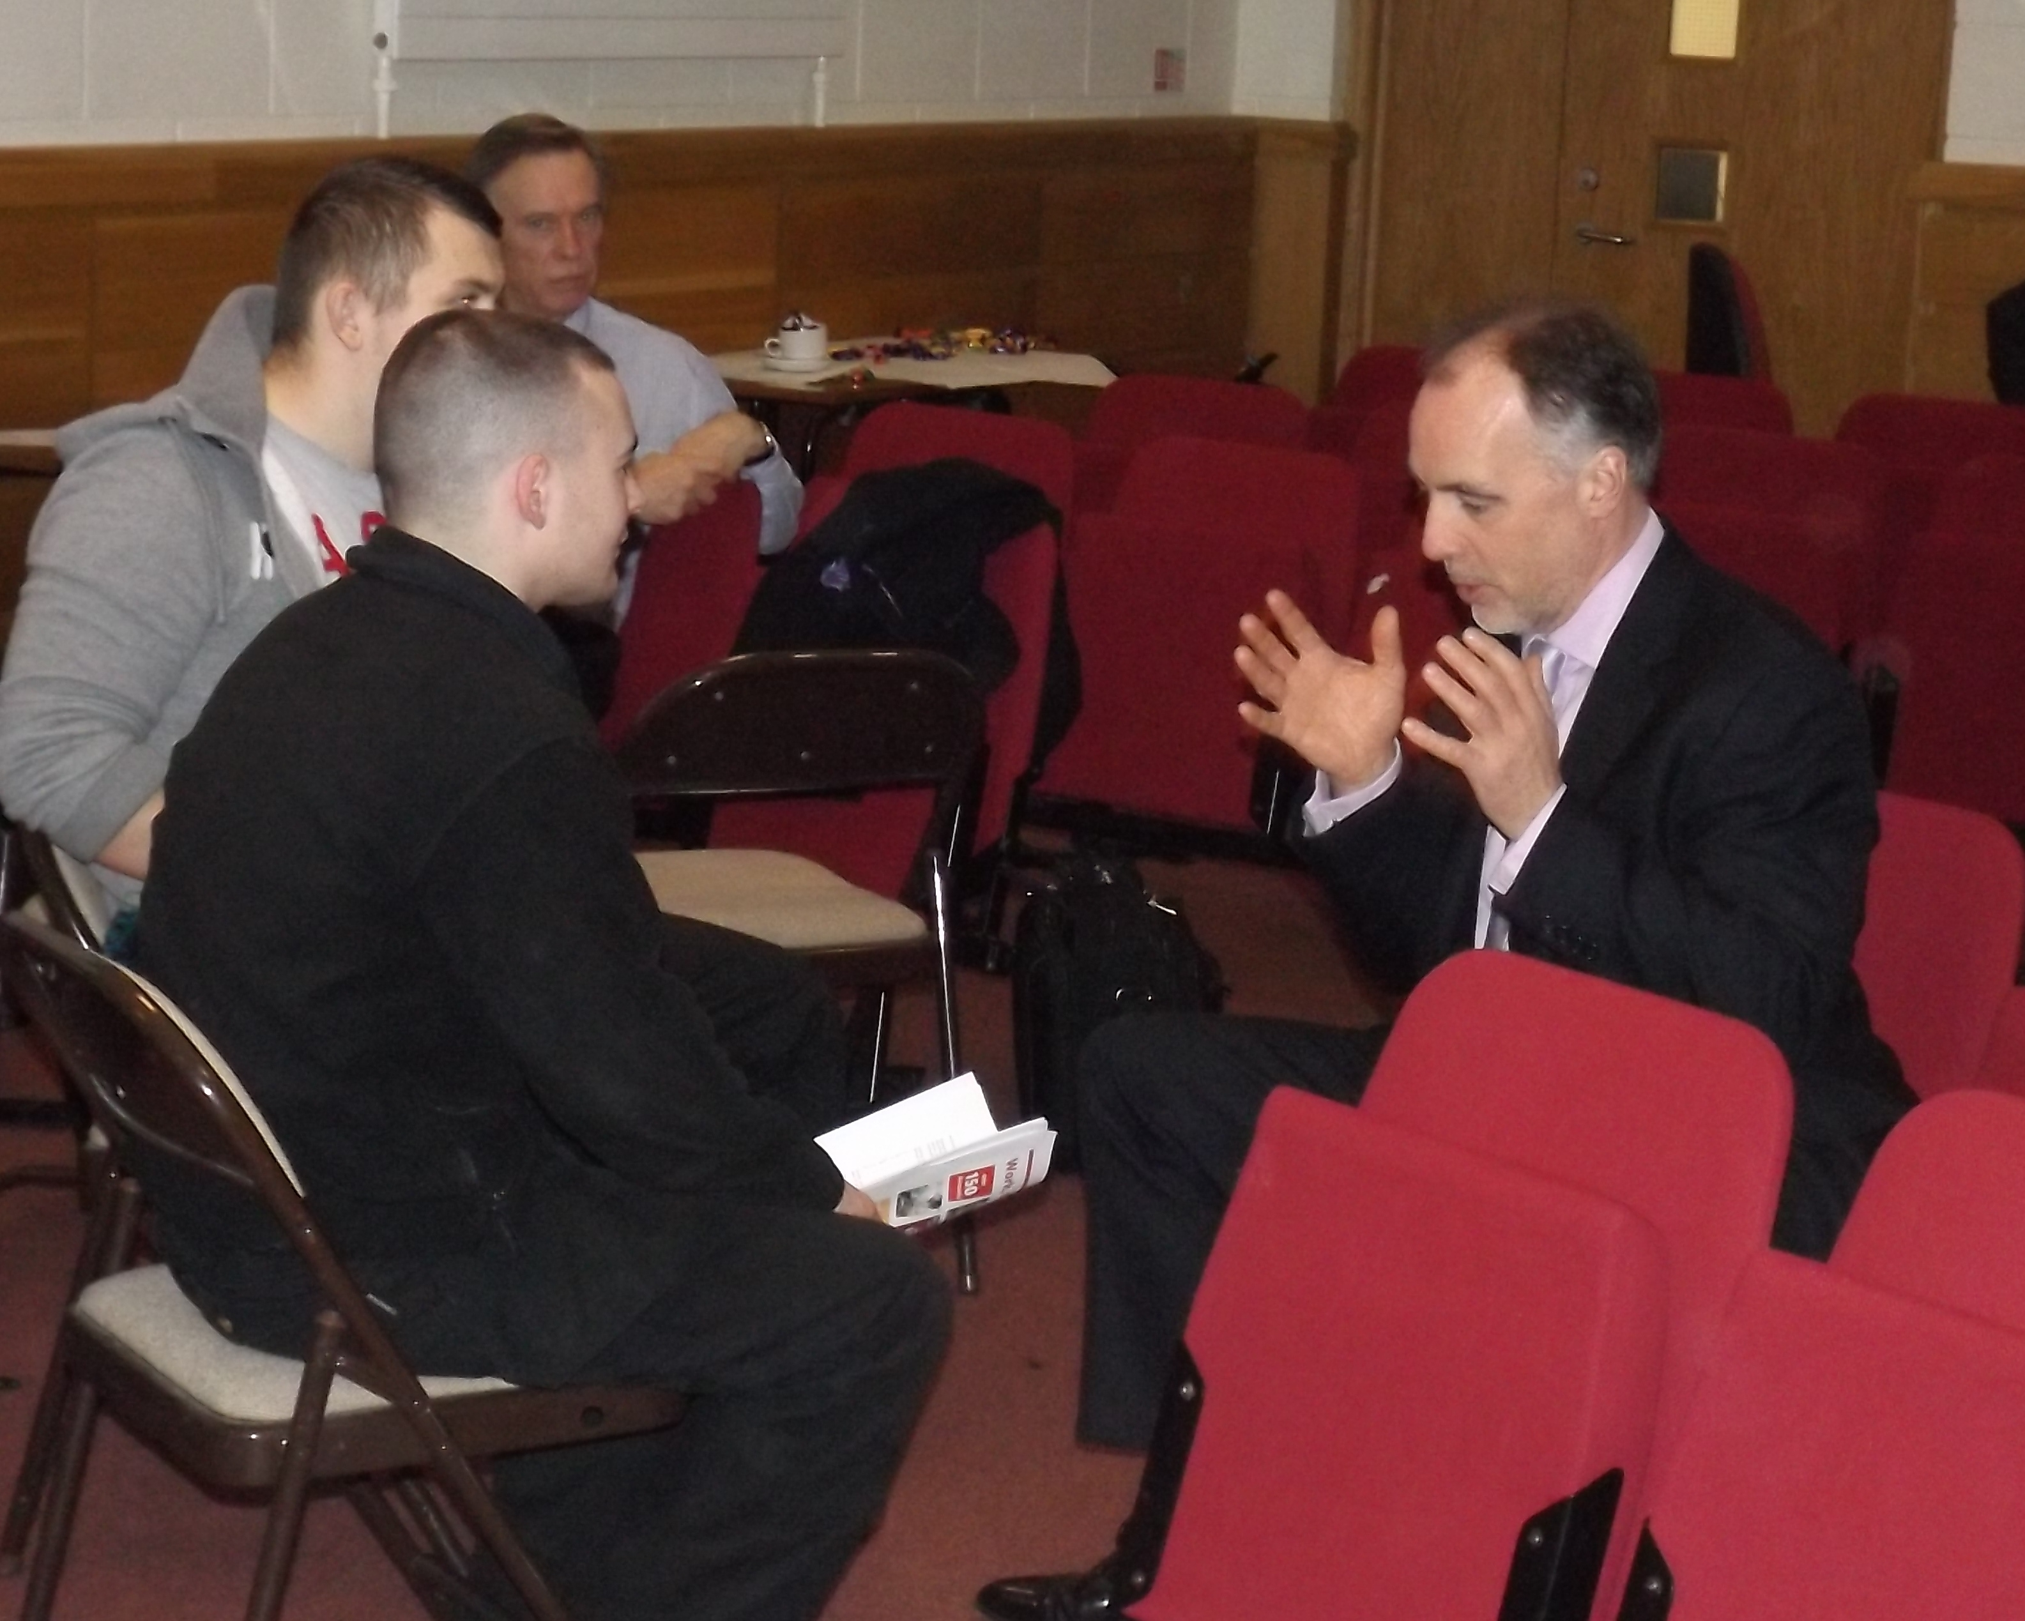
Apprentices in the room!

Slide 10
Meet the decision Maker
Congratulations, you’re now in in charge of how apprenticeships work. Being the boss has its perks, you get to tell people what to do – more of that later. Being the boss also means making some tough decisions, including where to spend the money.
Using the budget allocated to you decide what your spending priorities would be. What deserves a lot of your attention and money, what’s not so important?

Slide 11
Priorities
Pay
Careers Advice
Working Conditions
Learning on the job
Learning off the job
Access to Apprenticeships
Respect as an apprentice
Involvement in decision making
Making sure apprentices get a job when they finish

Slide 12
Telling Stories 1 – Travel example
Steffan works for a firm building yachts. He travels about an hour to work. First a bus, then a train, then a short walk to the docks.
On the day he’s in college there’s a bus trip, then on the train, then another bus.
Steffan is paid the apprentice minimum wage but his travel costs an average £10 a day.

Slide 13
Telling Stories 2
In groups think about:
What went wrong?
What would improve that?
Who is the decision maker?
What could they do?

Slide 14
Telling Stories 3
In a perfect world everyone would have an excellent apprenticeship. The world isn’t perfect though.
To get things changed we work together with other apprentices.

Slide 15
Telling Stories - The Apprentice Ask.
Using these ideas. What would you ask decision makers to change about apprenticeships?
We feel this:
Because this happens:
We want these people:
To do this:

Slide 16
Get in touch
This is just a brief overview of some of the activities that colleges have used to engage apprentices in Learner Voice. For a more detailed description and further examples please do get in touch:
Ben.kinross@nus.org.uk
Apprentice engagement officer

