Slide 1

International Students – Opportunities and Challenges
Shreya Paudel, NUS International Students Officer
Joy Elliott-Bowman, Campaigns & Policy Officer – International Students

Slide 2
What will this session cover?
The International Student Experience
What are the national issues shared by many international students?
What are the educational issues faced by international students?
What are the student experience issues faced by international students?
Internationalisation:
What does it mean to be an “internationalised SU”?
How do we become an internationalised SU?
How do we use the Internationalise your Students'’ Union Toolkit
Notes:
Shreya –
This session is going to give you a short explanation of key campaigning methods and then we will get to the interesting things – the issues.
This session will cover the four key national issues that NUS International Students Campaign will be focusing on this year.
The other session which will be about campaigning locally

Slide 3

The International Student Experience

Slide 4
“New Deal” for International Students:
Reinstate the Post-study Work visa
Create a Student Protection Scheme
Give Access to HE for Asylum Seekers
No more Net-migration targets

Slide 5
Policy context
In its manifesto in 2010, the Conservative party promised to reduce net migration to the “tens of thousands”. The government is way off track to meet its target. In August 2014, 9 months before the ‘deadline’ of the next general election, it was announced that net migration into the UK increased by more than 38% to 243,000 in 2013-14.
This could be because of BIS’ strategy to increase international students by
90,000 per year…

Slide 6
New Deal for Work:
Reinstate the Post-study Work visa

Slide 7
A new deal for international students at work
Ask: NUS is calling on the government to provide all non-EU international students with the right to work, free from restriction, for a minimum of 12 months after study.
All students should have the right to apply their learning in a work environment for the benefit of themselves and the economy. Since 2012 restrictions on post-study work have made this almost impossible for international students.

Slide 8
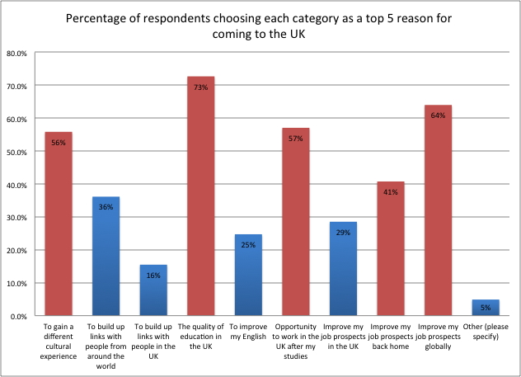
Why this ask? Because international students want it…
(NUS, 2012)
Notes:
Respondents were asked to select the top five reasons for why they chose to study in the UK. The
five most popular statements were: “the quality of education in the UK”, “to improve my job
prospects globally”, “the opportunity to work in the UK after my studies”, “to gain a different
cultural experience” and “to improve my job prospects back home”.
Interestingly, whilst having the opportunity to work in the UK after studies was the third highest
reason for respondents, improving their job prospects in the UK more generally was not a high
factor in choosing to study here. The most common reason respondents chose, at all levels of study, when deciding to study in the
UK was the quality of education. For undergraduates and foundation degree students, the next
most common factor was the chance to gain a different cultural experience, whereas, for both
types of postgraduate study the second most common factor was to improve job prospects
globally.
It is interesting to see that respondents from East Asia were the only group to have “to improve
my English” as one of the top three most common responses. Students from Africa also appear to
feel much more strongly that the quality of education was a factor in their decision making, with
84 per cent of African respondents selecting this, compared to 73 per cent overall. Respondents
from all regions had “improve my job prospects globally” as a top three most common response.

Slide 9
The impact of this policy
The removal of the post study work visa has been condemned by a broad swathe of commentators, for its impact on the UK’s status as a top centre for academia in the world. The Russell group is said to have complained to the Government that its universities are missing out on 5,000 international students a year because of the current visa rules.
Potential, current and past students from all over the world, as well as academics from across the UK, have condemned the policy as restrictive, unfair and a disincentive to study in the UK.
According to a House of Lords report, the "unwelcoming UK" has seen a drop in the number of international students studying science, technology, engineering and maths, which have fallen by more than 10% in the past two years. The message to potential students from around the world seems to be, that they'd be better off studying elsewhere.

Slide 10
Others calling for change
The Conservative Mayor of London, Boris Johnson, has criticised the policy for discouraging foreign students from coming to the UK.
The House of Lords Science and Technology committee have called for the reinstatement of the post-study work visa. And Universities UK are also calling on the government to reintroduce post-study work visas for all graduates from UK universities.

Slide 11
New Deal for Education:
Access for Refugees and Asylum Seekers

Slide 12
A new deal for asylum seeking international students
Ask: NUS is calling on the government to treat those seeking asylum as home students – which means access to funding and no more international student fees
Asylum seekers can be in the UK up to 9 years before their claim is resolved. That’s a lot of time to put your life on hold. They can not work and receive only £5 a day to live on. But they are charged international student fees and have no or limited access to government funding (depending on nation) for higher education.

Slide 13

Student Action For Refugees (STAR)

Slide 14
Local and National
STAR Groups exist in many unions and can be a source of activists on the issue.
STAR campaigns for universities to offer home fees and bursaries for asylum seeking students.
STAR are working with NUS to take the home student status for fees and funding national.
There is a “nations” context as Scotland already has home student fees and funding for a select number of asylum seeking, humanitarian protection and discretionary leave to remain students, but we need them to expand this.

Slide 15
New Deal for Education:
Student Protection

Slide 16
A new deal for global education
Ask: We want the government to put into place a national financial protection scheme for international students.
We call on government to establish a financial protection scheme into which all education providers have to pay, to ensure that students can continue to live and study in the event of institutional failure, or funding sources being severed by natural or civil crises in their home country.

Slide 17
What do I need to know?
International students undertake huge risks when they go abroad to study. They leave their own safety nets of friends and family for a new country, often having to adjust to a new language and culture. Countries such as the UK – the second largest host of international students, after the USA - have a duty of care to international students to provide support when things go wrong.
It is widely recognised that foreign students bring significant benefits to Britain.
Yet when a university or college loses their licence to teach international students, the students have 60 days to find a new place to study – with no right to refunds or
recourse.

Slide 18
Why are we asking for this?
Conflicts (such as Syria, Iraq, Palestine and others.
Current Sponsorship Crisis – over 12,000 current students expected to find a new place to study.
A note on existing hardship provisions…
Currently, there is no legal requirement that universities provide financial assistance to international students, while there are requirements for domestic students.
The 2014 NUS report found that 65% of HE institutions had a specific hardship fund for international students, and only 33% had a specific fund for a large scale crisis such as the conflict in Syria. Where they exist, hardship funds tend to be extremely underfunded. On average institutions allocated a total of £31,000 annually to hardship funds, spending just £8.40 per international student on hardship funding.
Notes:
Include the fact that currently private colleges have no requirement to hear complaints and no requirement for refund policies. Universities have the OIA but private and public colleges have no one to watch to make sure they are acting in the best interest of students. Someone needs to do this.

Slide 19
New Deal for Global Mobility:
No more Net migration targets

Slide 20
A new deal for global mobility
Ask: NUS doesn’t only want international students to be taken out of net migration figures; we want to scrap net migration figures all together.
We want political parties to put an end to playing politics with our world-leading education system. The use of a net migration target is a blunt and ineffective tool that ignores the real benefit that people coming to Britain can bring, to Britain and to those coming here.

Slide 21
What is the net migration target?
Net migration to the UK is calculated as the difference between the number of people entering the country and the number leaving. Therefore, reducing net migration means reducing immigration, increasing emigration – or both. The target applies to all immigrants and emigrants, including British citizens and those from other countries in the EU.
How is the government attempting to meet this target?
The government is way off track to meet its target. In August 2014, 9 months before the ‘deadline’ of the next general election, it was announced that net migration into the UK increased by more than 38% to 243,000 in 2013-14.
EU citizens accounted for two-thirds of this increase. However, the UK’s membership of the European Union requires that all citizens can travel, live and work freely across EU states, so their movement is beyond government control. (There are as many “Brits” in Europe as there are Europeans in Britain.)
International students are seen as one of the ‘easy hits’.

Slide 22
The benefits of immigration to Britain
Various studies have already shown that immigrants, and international students in particular, bring over-all benefit to Britain. Setting a target for net migration is guided purely by a misguided ideology.
Existing proposals for change
The think tank British Future has called for international students to be removed from the overall migrant figures, and therefore for students to be unaffected by the migration cap.
Others have gone further, including the Conservative MP Mark Field, National Association of Schoolmasters Union of Women Teachers and media outlets including the Financial Times, all calling for the migrant cap to be scrapped altogether.

Slide 23
Discussion
Which of the election asks are you most interested in discussing?
In Groups discuss:
How would you pitch this ask to students (Home, EU and Non-EU)?
You have 30 seconds to convince a general election candidate to talk to you about this ask – what would you say?
What activities would you undertake to engage both students as voters and the wider community or candidates in this ask?

Slide 24
Fixed Fees for International Students
Creating a Fair Fee system for international students

Slide 25
Our fixed fees campaign has one simple goal: to abolish in-course fee increases.
We want a fixed-fee guarantee for all international students.

Slide 26
Policy Principles
No surprises
The cost of a programme must be clear to students from the outset. Not only should students understand in-course costs, but they should know the tuition fee levels for the entire award.
Fixed Fee Guarantee
The tuition fee that a student pays in the first year of their study should be fixed for the duration of the programme, without any increase, for contiguous years within awards.
Interest Rate Guarantee
If the fixed fee guarantee is not possible, as an absolute minimum, fee increases must be limited to the level of inflation. The institution will not reserve the right to increase fees beyond this level, from year to year during a student’s programme.

Slide 27
Policy Principles(2)
Governing fee levels
Students’ representatives should be involved in all decisions on fee setting within an institution. Any change in fee levels should be justified, evidenced and transparent.
Support and flexibility: the Acts of God and War principle
Sometimes the cost of paying fees increase for reasons beyond the institution’s control, such as with currency crises which impact the exchange rate; additionally environmental emergencies and financial sanctions during times of international conflict can interrupt fee payments. In these circumstances, institutions should pledge to be flexible and supportive in their fee arrangements.

Slide 28
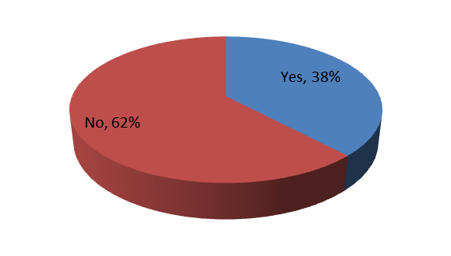

Who guarantees fees?
Universities UK: 58% do NOT guarantee fixed-fees
2012-13
2013-14

Slide 29
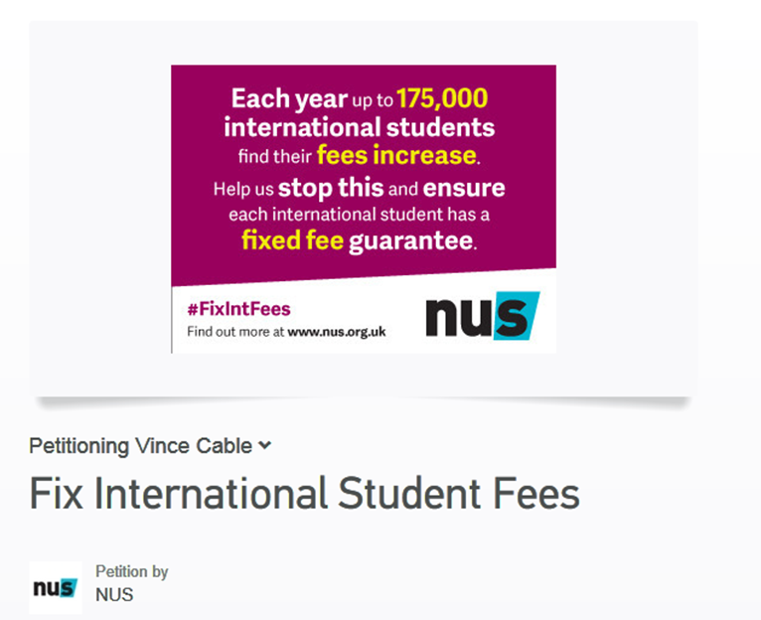
Get the research report
http://www.nusconnect.org.uk/news/article/international/NUS-launches-Fix-International-Fees-Campaign/

Slide 30
International Students in Crisis

Slide 31
When crisis hits…
International students can face a range of crisis:
Conflict and Civil war (Iraq, Syria, Palestine & Israel)
Natural disaster (Indonesia, Sri Lanka, Haiti)
Political upheaval (Libya, Egypt, Zimbabwe)
Political mismanagement or partisan politics (Nigeria, Ghana, Venezuela)

Slide 32
Creating a Partnership approach…
When the conflict in Syria started to impact universities and colleges in the UK, most did not assist students, and many of those that did waited until being asked by BIS or their Students’ Union to step in.
The conflict in Iraq now sees these students facing a similar situation – and BIS and Students’ Unions need to start all over again.
Wouldn’t it be great if there was a better system….
We want to help SU’s build a strategy
With universities.

Slide 33
A special note on Hardship funds…
Hardship funds for international students exist in only select universities and colleges
More can be done to support international students who face hardship – and both the government and institutions have a role to play.
NUS published research in June 2014 outlining the Hardship situation for International Students – www.nusconnect.org.uk/resources/international/Widening-the-Safety-Net-Bringing-Financial-Safety-to-International-Students
The average UG course costs £12,000 per year. PG courses can be up to £40,000. Fees are normally market rate and above the cost of delivery.
The average contribution of a university to create an international students’ hardship fund is £8.40 per international student

Slide 34
Housing Guarantors for International Students

Slide 35
Housing Guarantors
What is a housing guarantor?
Someone who provides a guarantee that rent, bills and or damage will be covered in private rented accommodation.
Often requires a UK resident.
EU and non-EU students are unlikely to have this.
What can be done?
Some unions have campaigned for the university to be the guarantor.
Others have used private companies such as Housing Hand.
Housing How-to – International Students –
http://www.nusconnect.org.uk/resources/open/housing/HOUSING-HOW-TO-International-Students/

Slide 36
Discussion
Which of the issues identified are you most interested in discussing?
Are there other issues you have identified you would like to discuss?
In Groups discuss:
Who in your institution would be able to impact this issue (students union included)?
What actions has your institution/SU already taken?
How far would you need to go to reach a goal on this issue?
How would you get international students involved in addressing this issue?

Slide 37
Internationalising your Students’ Union:
Impacting the international student experience
Impacting home students internationalisation.

Slide 38
http://www.nusconnect.org.uk/internationalisation/
HE Toolkit
FE Toolkit
The Toolkits are a self-assessment exercise on key areas of internationalisation as they apply to students unions

Slide 39
What do we mean by Integration?
How would you define Integration?
Integration
The process of developing activities and processes that enable international and home students to mix on a voluntary basis.

Slide 40
What do we mean by Internationalisation?
If you went back to your students union and asked them to create a word-map of “Internationalisation” what would it look like?
Internationalisation –
HEA - ”preparation of all UK HE graduates to live in, and contribute responsibly to, a globally connected society”
Dictionary – “The ability to overcome borders”

Slide 41
Key principals of an Internationalised Students’ Union
Democracy – We will ensure that all international students are able to participate in the democratic processes and representative structures of our students’ unions
Campaigning - We will campaign for positive change and lobby to make sure the voices of international students are heard locally, nationally and internationally.
Activities and Participation – We will create opportunities for home and international students to come together through societies and activities.
Membership Services – we will develop services that meet the needs of our international student members.

Slide 42
Key principals of an Internationalised Students’ Union
Commercial Services – We will develop services that meet the needs of our international student members.
Communications – We will develop genuine two-way communication between our students' unions and our international student members and ensure our communication is accessible and appropriate.
Officer and Staff Development – We will develop and promote learning and development opportunities for officers and staff.

Slide 43
Key principals of an Internationalised Students’ Union
Partnerships and Collaboration – We will develop networks at local, regional and national level to support internationalisation.
International Experience – We will provide an international experience for all students, make unions a space where home and international students can come together and promote a global perspective in all areas of union activity.

Slide 44
Discussion
Each of these areas have a series of questions in the toolkit to help you audit your students’ union…
In groups pick one of the areas:
What issues would you identify within your students union you may need to solve to achieve this aim?
What activities would you undertake to achieve them?
We will cover 3 areas per group
in 10 minutes.

Slide 45
What Next?
http://www.nusconnect.org.uk/internationalisation/case-studies/
Great case studies on activities (societies, volunteering, sport), representation, cultural awareness, getting extra staff, and getting international students involved.
http://www.nusconnect.org.uk/internationalisation/resources/
Tips on building a strategy for long-term internationalisation.

Slide 46
Help us understand more…
Last week NUS launched a new survey to understand student experiences of belonging, integration and xenophobia on campus and in our communities.
Promote the survey: http://nussurveys.org.uk/Surveys/Policy/xenophobia_research.htm
Every union to get 100 responses gets their own personalised data set.
Get resources to promote the survey - http://beta.nusconnect.org.uk/resources/#

Slide 47

Questions and Contact
Questions?
Keep in touch:
@shreya_paudel
Shreya.paudel@nus.org.uk
Notes:
Shreya – Are there any questions? Keep in touch.
Sign the email list form at the registration desk to get our updates.

