Slide 1
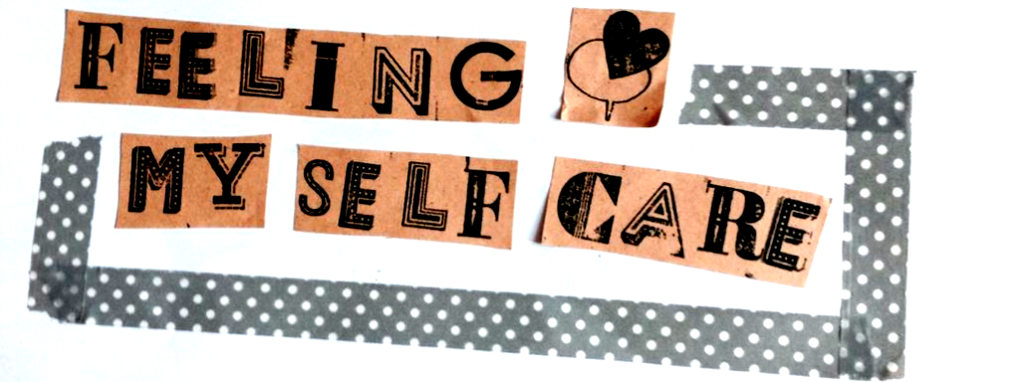

Slide 2
Introduction

Slide 3
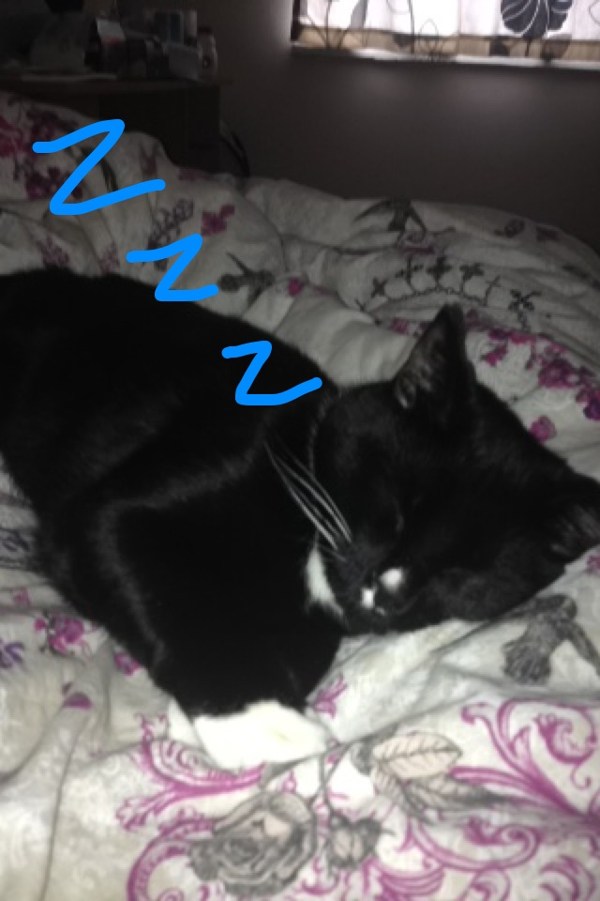
Aims and Objectives
To deconstruct the concept of "burn out" and learn about different causes, effects and how to tackle it.
To discuss different definitions of self-care and self-love and the barriers people face in engaging in them.
To learn practical ways to look after yourself and collectively support each-other's self-care.
"You may not control all the events that happen to you, but you can decide not to be reduced by them.”
- Maya Angelo

Slide 4
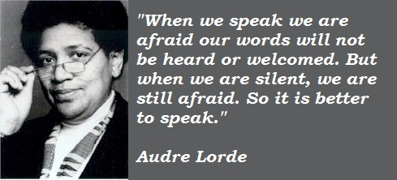
Safer Space
Don't talk over other people
Don't use offensive language
Use trigger-warnings when appropriate
Don't speak about others peoples experiences outside this space without their consent
No question is a silly question
Don't apologise for speaking, this is your space too!

Slide 5
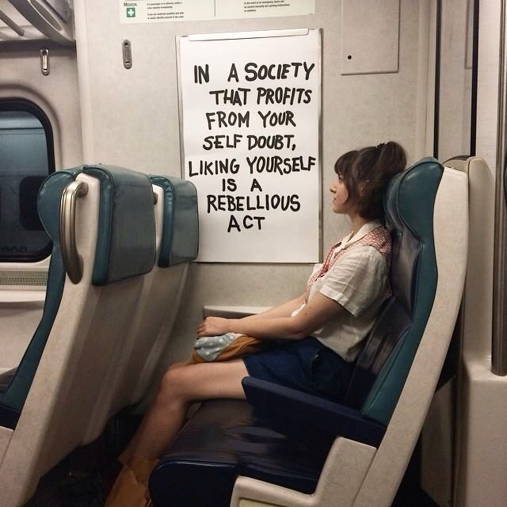
Ice-breaker
My name is...
My pronoun is...
I study...
I came here today because...

Slide 6
Self-care 101: What do we mean by self-care & self-love?

Slide 7
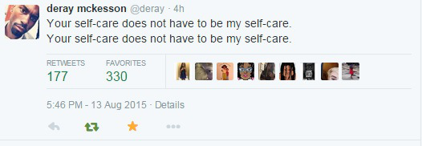
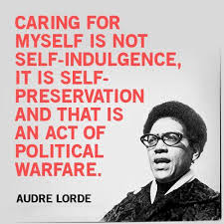
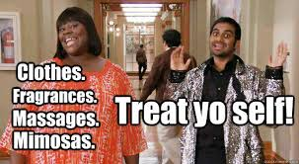
Definitions

Slide 8
You do you
For self-care I...
For self-love I...

Slide 9
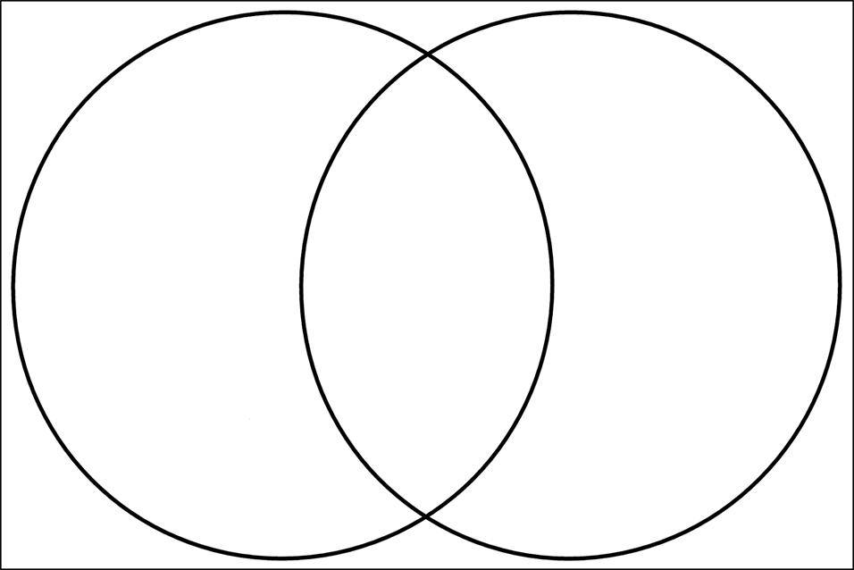
Self Care vs Self Love is...
Self-care
Self-love

Slide 10
Deconstructing "Burn out"

Slide 11
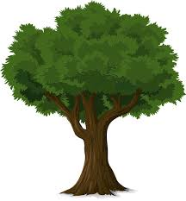
Burnout - Problem Tree
Effects
Root Causes

Slide 12
Barriers to self-care
What stops you from engaging in self-care?

Slide 13
Squad Care: How do we support
each other?

Slide 14
Squad Goals
What qualities do you look for in a supportive network?

Slide 15
Collective learning sets
Explain the problem
The group asks "Open" questions
The group gives advice

Slide 16
Practical tips

Slide 17
The #FeelingMySelfCare Rule
The Golden Rule: One should treat others as one would like others to treat oneself.
#FeelingMyselfCare Rule: One should treat oneself like they would treat others.
If you treated yourself how you treated other people that you cared about what would you do?

Slide 18
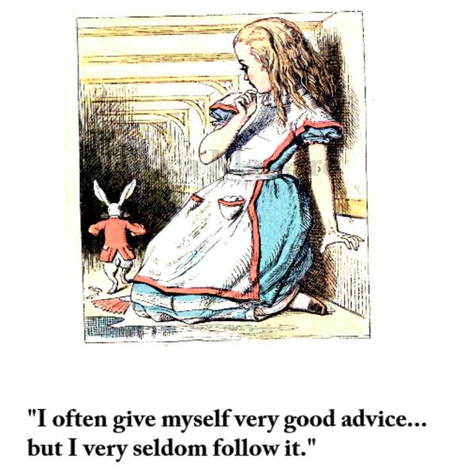
Mirror advice
Get your own barrier brick from the wall
Get into pairs
Swap bricks with your partner
Pretend the barrier brick is your issue and ask your partner for advice.

Slide 19
Good bye and take care!

