Slide 1

The Bairn Necessities
Student parents’ experiences of education at college and university in Scotland

Slide 2
Research Methods
Survey
FOIs to all colleges and universities
Individual interviews
Past research from NUS/other organisations
  Meet the Parents (NUS)
  Student Pregnancy and Maternity (HE) 2010 (Equality Challenge Unit)

Slide 3
Survey Results
721 respondents
Majority from colleges
Very low response rate
from universities
83% respondents
were women
51% aged 31 or older
92% study full time

Slide 4
Headline findings part 1
Culture of institutions not ‘understanding’
Student parents make up 7%-19% of student population
Of those who received childcare funding, it only covered the costs of childcare for 50% respondents
The other 50% had a monthly shortfall of
  £20-£100 at college
  £100-£700 at university

Slide 5
Headline Findings part 2
Student parents can lose some child benefits whether or not they take a student loan.
Gap in support for women using education to escape domestic violence.
More nursery places and child friendly spaces on campuses are needed.

Slide 6
Key Recommendations 1
All colleges and universities should be required to keep a record of how many student parents are studying at their institution.
Institutions should use this data to embed a holistic, integrated system of support for student parents, to include detailed and timely information about services available and entitlements.

Slide 7
Key Recommendations 2
The whole system of self-certificates, attendance and absences should be reviewed by Scottish Funding Council in partnership with colleges, to create a more flexible system that reflects the needs and life circumstances of student parents.
A comprehensive review of the allocation of nursery places both at on-campus and local facilities should be undertaken to ensure the needs of student parents are being met.

Slide 8
Key Recommendations 3
Colleges and universities where possible must align their term times with school holidays.
College, universities, and students’ associations should work through NUS’s 10 steps from child free to child friendly institutions.
Staff at colleges, universities and students’ association should be trained to recognise students that may be experiencing or recently experienced domestic abuse, and are able to signpost those students to receive the appropriate support.

Slide 9
Key Recommendations 4
Scottish Government should uses new powers to review how financial support given to student parents interlinks with the Carers Allowance and other benefits the student may be entitled to, ensuring that student parents receive the best possible support.
Students’ associations should recognise the time limitations student parents experience, and set up a student parent network.

Slide 10
Resources
The Bairn Necessities report
Executive summary
Self evaluation tool
Guide to support for student parents (institutional breakdown)
10 steps from child free to child friendly poster
www.nusconnect.org.uk/nus-scotland

Slide 11

Bring the Bairn Necessities to life
on YOUR campus

Slide 12
The situation on YOUR campus
In small groups look at the guide to support for student parents for your college/university and use the self evaluation tool to pick the top 3 priority recommendations you’d like to see implemented.

Slide 13
Campaigning for change
Building a campaign team
Communicating your message and putting together your arguments
Map your stakeholders and identify the decision maker
Plan your actions

Slide 14
Build a campaign team
Potential Campaigner | Why would they be interested? | How can you get them on board? | What can they do? | What will they get out of it?

Slide 15

Communicating your message
Anger
(sense of injustice about the issue)
Hope
(doesn’t have to be this way)
Action
(give them a clear action)
Isn’t it awful that…
Did you know that…
It’s so unfair that…
We know how we can fix this…
Wouldn’t it be great if…
If everyone came together…
Sign our petition!
Write to your MP
Come to our campaign meeting!

Slide 16
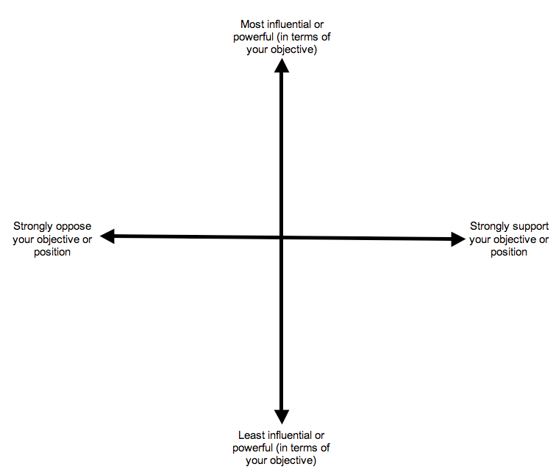
Map your stakeholders

Slide 17
Plan your actions

Slide 18
Next steps

Slide 19
Get in touch
Angela Alexander
NUS Scotland Women’s Officer
Angela.Alexander@nus-Scotland.org.uk

