Slide 1
NUS Membership Services Conference 15th August 2017
Lindsey Poole
Director, Advice Services Alliance
director@asauk.org.uk

Slide 3
No such thing as typical advice centre….

Slide 4
Or typical advisers…

Slide 5
Or typical client group……

Slide 6
Your role within the sector
Significant sub sector in own right (600 SU’s)
Relationship between academic and personal problems
Links with other groups (for example, Youth Access)
Source of evidence regarding young people’s advice needs
Share same problems and issues
triage, case work, on-line advice
Important ‘greenhouse’ for new staff and new leaders
Public Legal Education and preventative work

Slide 7
Student Unions 2017
Anglia Ruskin
Bristol
Central Lancashire
De Montfort
Huddersfield
Kent
Leeds
Loughborough
Manchester
Manchester Metropolitan
Nottingham Trent
Nottingham
Oxford
Reading
Sheffield Hallam
Sheffield
Swansea
Teesside
UWE
Wolverhampton

Slide 8
Students founded advice services

Slide 9
Policy | Outcomes | Funding
Client Engagement | Challenges | Digital by default
Meeting need | Quality | Advice Channels

Slide 10
A week is a long time in politics….

Slide 11
Disasters do not just happen, they are made
Notes:
Fortunately for themselves and the world, nearly all men are cowards and dare not act on what they believe. Nearly all our disasters come of a few fools having the courage of their convictions.
The argument is that natural disasters do not exist because all disasters require human input. Nature sometimes provides input through a normal and necessary environmental event, such as a flood or volcanic eruption, but human decisions have put people and property in harm’s way without adequate measures to deal with the environment. The conclusion is that those human decisions are the root causes of disasters, not the environmental phenomena.
Kelman, I. 2010. Natural Disasters Do Not Exist (Natural Hazards Do Not Exist Either) Version 3, 9 July 2010 (Version 1 was 26 July 2007). Downloaded from
http://www.ilankelman.org/miscellany/NaturalDisasters.rtf

Slide 12
Change in the air..…
Investigation into the circumstances of Grenfell Tower
Fees for Employment Tribunals and challenges to ‘Gig’ economy
End of Austerity Policies
Money being found for deals
Brexit negotiations and deals
Review of Legal Aid and Sentencing of Prisoners and Offenders Act
Weaker government post election (opposition/House of Lords)
Possibility of another election/referendum…

Slide 13
Policy | Outcomes | Funding
Client Engagement | Challenges | Digital by default
Meeting need | Quality | Advice Channels

Slide 14
Failures of government

Slide 15
Policy | Outcomes | Funding
Client Engagement | Challenges | Digital by default
Meeting need | Quality | Advice Channels

Slide 16
Funding
Where does the money come from?
Who should pay for advice?
What can we learn from new funding mechanisms?
How do we maintain independence from funders?
How do we make more effective use of funding we have?
How do we target funding to meet those most in need?
What do we do when the money runs out?

Slide 17
Policy | Outcomes | Funding
Client Engagement | Challenges | Digital by default
Meeting need | Quality | Advice Channels

Slide 18
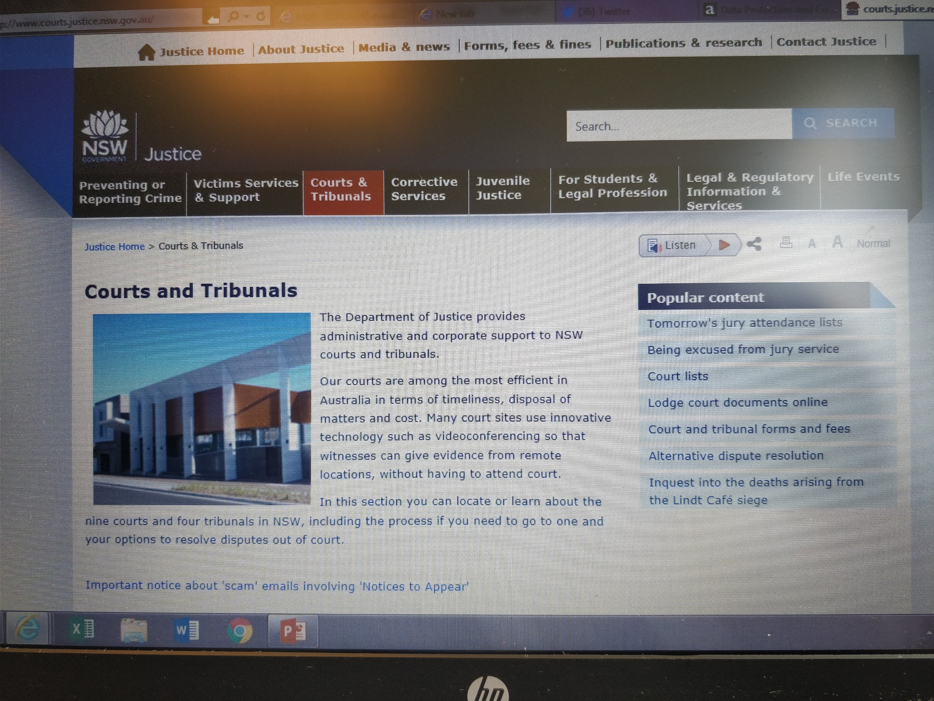

Slide 19
Policy | Outcomes | Funding
Client Engagement | Challenges | Digital by default
Meeting need | Quality | Advice Channels

Slide 20
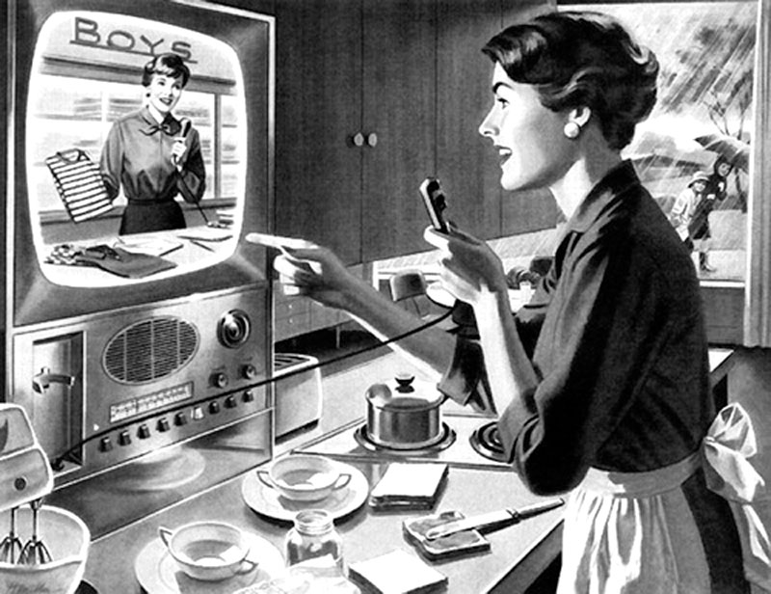
New channels for advice giving

Slide 21
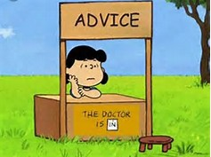
The human agency

Slide 22
Policy | Outcomes | Funding
Client Engagement | Challenges | Digital by default
Meeting need | Quality | Advice Channels

Slide 23
Recognised advice organisations
Organisations actually giving advice
1,500
15,000+
700

Slide 24
Policy | Outcomes | Funding
Client Engagement | Challenges | Digital by default
Meeting need | Quality | Advice Channels

Slide 25
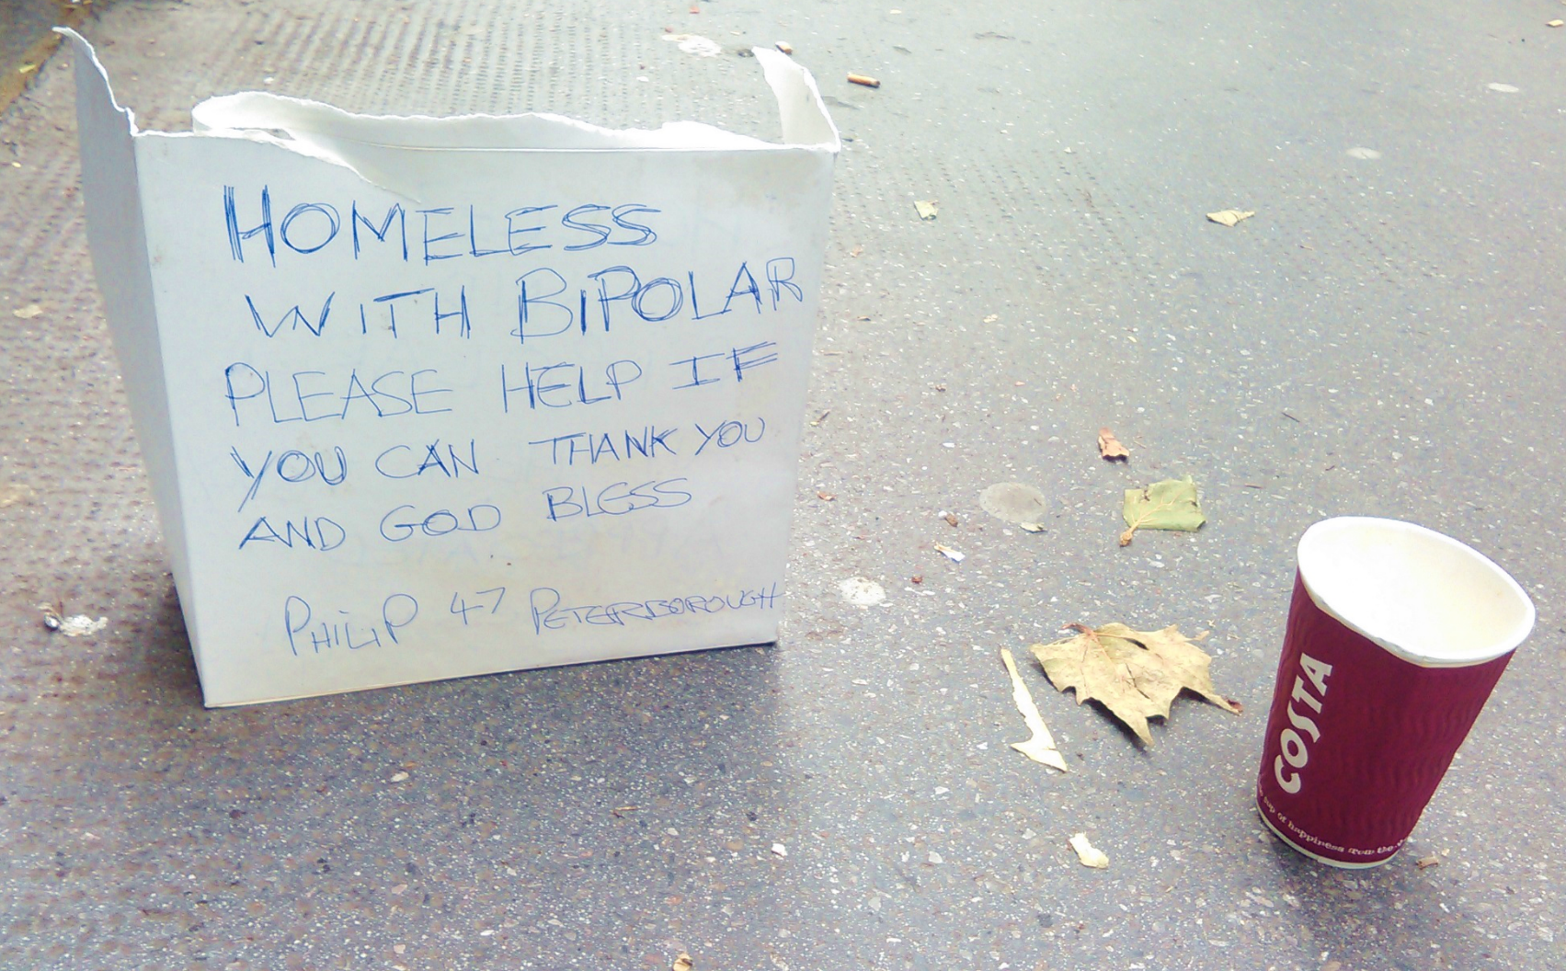
Philip, 47, Peterborough

Slide 26
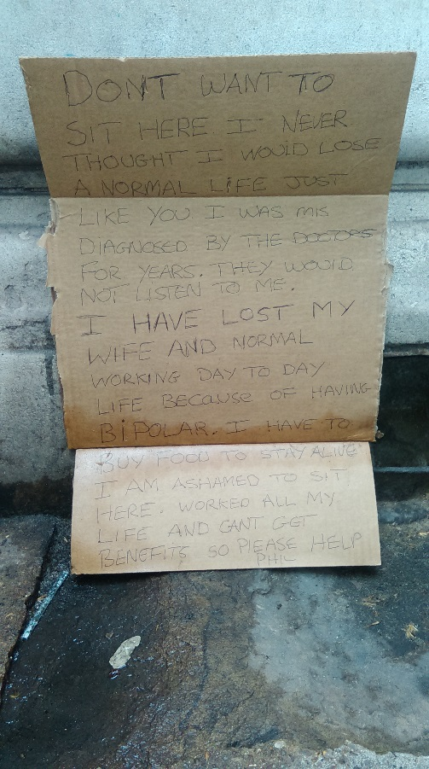
And the next day…..
Don’t want to sit here. I never thought I would lose a normal life just like you. I was misdiagnosed by the doctors for years. They would not listen to me. I lost my wife and my normal working day to day life because I having bi-polar. I have to buy food to stay alive. I am ashamed to sit here. Worked all my life and can’t get benefits. Please help. Phil.

Slide 27
Policy | Outcomes | Funding
Client Engagement | Challenges | Digital by default
Meeting need | Quality | Advice Channels

Slide 28
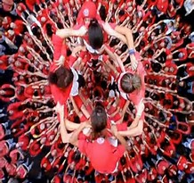

Slide 29
“We believe the evidence shows that not only is there a need for advice services now but if anything a strengthening of provision to tackle the increasing problems that people are likely to bring in the next few years”
Advice Services Crisis Working Party 1979

Slide 30
Why advice?
Promotes access to social justice
Ensures people receive entitlements
Holds government to account
Prevents pain and anguish
Produces other social benefits
Possibly cost effective

Slide 31
Sustainability verses Resilience
Sustainability
organisational survival
we keep going
maintain line and continue in time tested practices
chase the funding
Resilience
continued service delivery
we provide a service to those in need
bounce back, change and adapt
manage without funding

